Slide 1
Revelation 17 – 19
All passages are NKJV unless otherwise noted
JUDGMENT ON THE MYSTERIOUS MOTHER OF HARLOTS
Notes:
Up to this point, we have not had much spoken about the mysterious Babylon. We had a short burst in 14:8 of her demise and crime. We find her end again referred to in the seventh bowl in 16:19 where she is divided into three parts and her power is destroyed. This inspired text reaches a climax about Babylon in chapters 17-19. That so much ink is spilt on her shows us the significance of the event. Without this text we would be left to wonder who Babylon is exactly. This section shows us her story, her identification and her end. Chapter 17 explains her identity. Chapter 18 describes her fall. Chapter 19 the rejoicing over her by the faithful.
There are three distinct alleys with Satan. There is the sea-beast (13:1-4). This speaks of Satan’s use of intimidation. There is the land beast (aka “false prophet”) found in 13:11ff. This speaks of Satan’s use of deception (13:11-14). Babylon the great is the city which sits upon the beast (17:1, 2). She is Satan’s tool of seduction.
This is important because man’s walk is composed by three things. He walks according to his will, his intellect, and his emotion. Satan will try to control his walk by intimidating his will. Or he will try to cloud his intellect with misinformation and deception. His third approach is to seduce by what he is emotionally attracted to. Make no mistake, he often succeeds in one of these areas to derail us.

Slide 2
IDENTIFYING THE HARLOT
QUESTION 1, “Who is the harlot and why?”
QUESTION 2, “How was the woman dressed?”

Slide 3
IDENTIFYING THE HARLOT AS ROME
A GREAT CITY (17:18; 18:16)
SITS UPON MANY WATERS (17:1)
IDENTIFIED AS PEOPLES, NATIONS, ETC. (v. 15)
SITS UPON THE BEAST (17:3, 7)
BEAST IS ROMAN EMPIRE (cf. 13:1ff; Dan. 7:1-8)
Notes:
It only makes sense that Rome sat upon this kingdom and not Jerusalem.

Slide 4
IDENTIFYING THE HARLOT AS ROME
ARRAYED IN PURPLE, ETC. (17:4)
SEVEN MOUNTAINS (17:9)
REIGNS OVER THE KINGS OF THE EARTH (17:18)
DISCIPLES RESPONSE (18:20)
COMPARE AGAINST JERUSALEM (Lk. 19:41-44)
Notes:
Purple, the attire of rulers and wealthy people (Lk. 16:19). If she were a woman today, she would be on TV in the Lifestyles of the Rich and Famous.
Seven mountains is another indicator of Rome. The Seven hills of Rome were a commonplace figure with Latin poets.
“Reigns” present tense. Which city would the readers in John’s day thought of with this expression in 17:18? The only city that qualified was Rome. They are as kings in reigning with the beast (17:12).

Slide 5
QUOTES
ROBERT HARKRIDER
“Another mistake made in viewing Jerusalem as the harlot is to see her downfall in A.D. 70 at the hands of the Romans to be the same event as the battle of Armageddon. That interpretation radically changes the thrust of the Revelation visions. Those who accept that interpretation agree that up to this point the beast and false prophet represent the Roman Empire and its paganism of Caesar-Worship. They agree that Satan controls this kingdom of men and is using it to wage war against the spiritual kingdom of God. Why then, would there be a diversion from this basic theme to describe how God used this wicked kingdom to destroy a wicked city of Jerusalem? Not only that, but this interpretation demands two battles – the destruction of Jerusalem and later the fall of the beast and false prophet. The reader of Revelation has been prepared. . .”

Slide 6
QUOTES
ROBERT HARKRIDER
“. . .for only one battle on that great day of God Almighty. The beast (Roman Empire) and the false prophet (paganism) are the entities being defeated by God at the battle of Armageddon, not Jerusalem and the Judeo economy.”
“Those expositors who believe Revelation 17 is speaking of Jerusalem usually base their reasoning on Scriptures other than Revelation where God clearly promised that the Romans would destroy Jerusalem (Matt. 24; Luke chapters 17, 21). Then they conclude that Armageddon is the fulfillment of that prophecy. A proper exegesis, however, recognizes that a word or a phrase used in one context does not necessarily have the same definitions or meaning in a different context. . . .”
Notes:
This is made evident by the expression of laying hands on someone (Lk. 20:19; Acts 8:19; 28:8)

Slide 7
QUOTES
ROBERT HARKRIDER
“. . .As an illustration, note how the word ‘faith’ is used in two different contexts: (a) ‘Whatsoever is not of faith is sin’ (Rom. 14:23); and (b) ‘Faith comes by hearing the word of God’ (Rom. 10:17); therefore any doctrine that is not based on the word of God is sin (Gal. 1:6-8; 2 John 9). However, it is improper exegesis to combine the proposition of (a) with (b) even though both are truths. A study of the context of Romans 14 reveals that the word ‘faith’ is not referring to the word of God, but rather to the conscience of man. Therefore one confounds the two contexts if one is imposed into the other. In like manner, some have confounded the context of Revelation 17 by imposing the truth of Matthew 24 into it.”

Slide 8
QUOTES
ROBERT HARKRIDER
“In fact, the context of Revelation 14:8-10 illustrates that what Babylon does, the beast does. Their actions are not separate. She exercises the power of the beast and seduces the nations to worship the beast. Jerusalem never did this, but Rome certainly functioned in that way. Rome made all nations drink of the wine of the wrath of her fornication. How did she do this? This passage explains that the wrath is God’s because of her spiritual fornication. Her fornication was the act of worshiping the beast! All nations that were influenced by her in this paganistic worship suffered the wrath of God.”

Slide 9
QUOTES
ROBERT HARKRIDER
“The description of the harlot fits only late first century Rome. What is about to be revealed in the next three chapters is an enlargement upon the final judgments of God as summarized in the seven golden bowls of wrath. The battle of ‘that great day of God Almighty’ was introduced in 16:12-16, but it is not described until 19:19-21. So much importance was attached to the great city of Rome from which emanated the paganistic god-Caesar worship that two chapters portray her doom. Rome’s demise had already been foreshadowed in 14:8 and 16:19, but now this vision magnifies the events as the reader must behold the murderous harlot that rides upon the blasphemous beast.”

Slide 10
17:1, 2
AN ANGEL
(ONE OF THE ORIGINAL SEVEN IS NOW TALKING WITH JOHN)
GOING TO SHOW THE JUDGMENT OF THE HARLOT
THE NEXT THREE CHAPTERS ARE AN ENLARGEMENT OF THE SEVEN BOWLS OF WRATH AND OF “THAT GREAT DAY OF GOD ALMIGHTY” (16:14)

Slide 11
17:2 (THE FORNICATION OF NATIONS)
HOW COULD THE KINGS OF THE EARTH PARTAKE OF THIS FORNICATION?
ROME WAS THE CAPITAL AND WIELDED HER INFLUENCE UPON ALL NATIONS
USED WEALTH AND POWER TO SEDUCE THE NATIONS TO WORSHIP THE EMPEROR (13:15-17)
Notes:
“…what [Babylon] has written all over her is fornication, fornication, fornication. We are only too familiar with this word’s Greek root, porn-’ and five times John repeat it, not as one relishing it but as one trying to vainly to spit out a filthy taste.” –Wilcock, Michael, The Message of Revelation: I saw Heaven Opened, The Bible Speaks Today, ed. John R. W. Stott, 1975. p. 159.
The word adultery is not used here as some translations supply. It is fornication. This again emphasizes the seductive element of the Devil’s work.
Rome preferred to retain local authorities who would comply with the emperor. The Herod dynasty is an example of this.

Slide 12
17:3, 4
SEES WOMAN ON A BEAST
CONTRASTS TO WOMAN OF CHAP. 12
THIS WOMAN IS IN COMPLETE ACCORDANCE WITH THE DRAGON AND GLADLY SITS UPON HIS BEAST
ANYONE WHO DEEMS MATERIAL THINGS AS PRIMARY IMPORTANCE WILL BE SWAYED BY HER
Notes:
On many waters—her relationship to the masses of humanity. On the beast—her relationship to the empire. Sitting on speaks of her rule and control.

Slide 13
A HARLOT CITY OF OLD
NAHUM 3:4-7
4 Because of the multitude of harlotries of the seductive harlot, The mistress of sorceries, Who sells nations through her harlotries, And families through her sorceries.
5 "Behold, I am against you," says the LORD of hosts; "I will lift your skirts over your face, I will show the nations your nakedness, And the kingdoms your shame.
6 I will cast abominable filth upon you, Make you vile, And make you a spectacle.
7 It shall come to pass that all who look upon you Will flee from you, and say, ‘Nineveh is laid waste! Who will bemoan her?’ Where shall I seek comforters for you?"
Notes:
It is not unusual to find a city described as a harlot. Nineveh was referred to as such in Nahum. Jerusalem was in Jer. 2:20.

Slide 14
COMPARISONS OF THE BEAST
REVELATION 13
OUT OF THE SEA
7 HEADS, 10 HORNS
WARS WITH SAINTS
REVELATION 17
OUT OF THE BOTTOMLESS PIT
7 HEADS, 10 HORNS
MAKES WAR WITH THE LAMB

Slide 15
MARVELED WITH GREAT AMAZEMENT (17:5-7)
QUESTION 3, “Why do you suppose John ‘marveled with great amazement’?”
DRESSED SO FINE YET SO UNGODLY
DRESSED IN LUXURY BUT DRUNK WITH THE BLOOD OF SAINTS
SITTING ON TOP OF A SEVEN HEADED MONSTER

Slide 16
Mystery, Babylon the Great, the Mother of Harlots and of the Abominations of the Earth
“Babylon” code word for Rome
center of wealth and religion
“The Great” has to do with her pomp & prestige. . .a self-centered society
cf. Daniel 4:28-33

Slide 17
A society that is bent on self gratification and is set free from divine restraint becomes its own foe (cf. 17:16)

Slide 18
The Meaning of the Woman and Beast
Revelation 17:8-13
QUESTION 4, “How might we identify who the beast is in this chapter?”

Slide 19
17:8
“The beast that you saw was, and is not, and will ascend out of the bottomless pit and go to perdition. And those who dwell on the earth will marvel, whose names are not written in the Book of Life from the foundation of the world, when they see the beast that was, and is not, and yet is”
Difficult phrase to understand
The beast that you saw was—in the past
And is not—fades away
And will ascend—a resurgence
And go to perdition—will be destroyed
Will eventually be brought to ruin: “is going to perdition” as opposed to God Almighty (v. 11; 11:17)
Contrast 1:8: "I am the Alpha and the Omega, the Beginning and the End," says the Lord, "who is and who was and who is to come, the Almighty."

Slide 20
17:8
“The beast that you saw was, and is not, and will ascend out of the bottomless pit and go to perdition. And those who dwell on the earth will marvel, whose names are not written in the Book of Life from the foundation of the world, when they see the beast that was, and is not, and yet is”
Difficult phrase to understand
Possibilities:
Understand the beast to be represented and active in Nero, then went away, then came again in Domitian
Understand the beast to be represented in successive world empires
Satan works in kingdoms of men with ungodly leaders (cf. Matt. 4:8-10)
the beast ascended in the Roman empire

Slide 21
17:9
“Here is the mind which has wisdom: The seven heads are seven mountains on which the woman sits.”
QUESTION 5, “What three things does the woman sit upon in this chapter?”
many waters (v. 1)
scarlet beast (v. 3)
seven mountains (v. 9)
Rome literally has seven hills
but we must understand numbers and mountains as symbols

Slide 22
17:9
“Here is the mind which has wisdom: The seven heads are seven mountains on which the woman sits.”
emphasis is on power
seven (complete)
mountains (power, prosperity, grandeur, government)
Psalm 30:7; Jeremiah 51:25; Ezekiel 17:22; Daniel 2:35; Isaiah 2:1-4
meaning: woman (Rome) sits as a queen upon the harnessed power of the kingdom (cf. 18:7)

Slide 23
17:10-11
Meaning Of “Seven Kings”
literally seven Caesars?
literally seven kingdoms?
a mistake to force the literal…

Slide 24
7 Kings (17:10, 11)
If Caesars. . .
must retain “seven” as a symbol and not a literal number
PROBLEM: passage would indicate that the majority of the Caesars had already come and gone?

Slide 25
7 Kings (17:10, 11)
If Kingdoms (cf. Dan. 7:17, 23),
“seven” must be a symbol
the majority of kingdoms who oppose God have already come and gone
five have come
one is ⇛ Rome
one is yet to come ↦ ?

Slide 26
Robert Harkrider
“. . .if the number seven is understood to be a symbolic representation of the whole, or complete number, then the Roman Empire was but the embodiment and continuation of several kingdoms of men which Satan influenced to oppose God.”

Slide 27
The Seventh King
the seventh (future) king (kingdom) will continue for a short time
“short time” connected with Satanic release after 1000 years (20:3, 7, 8)
the beast was, and is not, yet is the eighth (kingdom) which is of the seven
mind-boggling statement
how could the 8th be of the seven?

Slide 28
Making Sense of 17:11
the beast has been embodied in all kings (kingdoms)
he is the “eighth”—the continuation, culmination, and completion
Significance of eight
Eight saved (1 Pet. 3:20)
Consecration of altar (Ezek. 43:25-27)
Completion of Tabernacles (Lev. 23:33, 39; Neh. 8:18)
“Eighth day” was the next “first day” of the week after a full week was completed (Jn. 20:19, 26)

Slide 29
Making Sense of 17:11
he is the “eighth”
A counterfeit of what is truly eight:
Astonishment fit for God, “Who is like the beast?” (13:4; cf. Ps. 113:5)
Two horns of a lamb (13:11)
Apparent wonders (13:13, 14)
The composite of all empires that oppose the Lamb
the thought is that Rome (6th) is just another venue that Satan used to opposed God and it will be destroyed like everything else that follows

Slide 30
Ten Horns (17:12-13)
QUESTION 6, “What are the ten horns and what do they do?”

Slide 31
Ten Horns (17:12-13)
10 horns identified as “kings”
probably “puppet” kings under Rome’s rule
No kingdom as of yet—ruled by Rome’s power and influence
not literally 10, but figuratively 10, the complete number of subservient kingdoms
had authority for a short time (1 hour)
were of one mind (unified) in opposing Christ
obeyed Rome’s dictates
relationship will ultimately turn into a love/hate relationship

Slide 32
The Lamb Overcomes (17:14)
final outcome made known
thematic for entire book
the Lamb will overcome
“Lord of lords” and “King of kings”
Jesus is the true supreme ruler
Jesus is the true God (cf. Dan. 2:47)
Notes:
If God can confuse the population of the world when they had one language, he can easily bring down the mighty Roman empire.

Slide 33
17:14
“These will make war with the Lamb, and the Lamb will overcome them, for He is Lord of lords and King of kings; and those who are with Him are called, chosen, and faithful.”
Those with the Lamb are called:
chosen
God has chosen a class of people who believe in His son and are baptized
being “chosen” doesn’t mean you cannot fall (1 Pet. 2:4, 9; 2 Pet. 1:10; 3:17)

Slide 34
17:14
“These will make war with the Lamb, and the Lamb will overcome them, for He is Lord of lords and King of kings; and those who are with Him are called, chosen, and faithful.”
Those with the Lamb are called:
chosen
faithful
must be faithful (Rev. 2:10)
faithfulness is how we keep our chosen place in Christ

Slide 35
Additional Explanation
Revelation 17:15-18

Slide 36
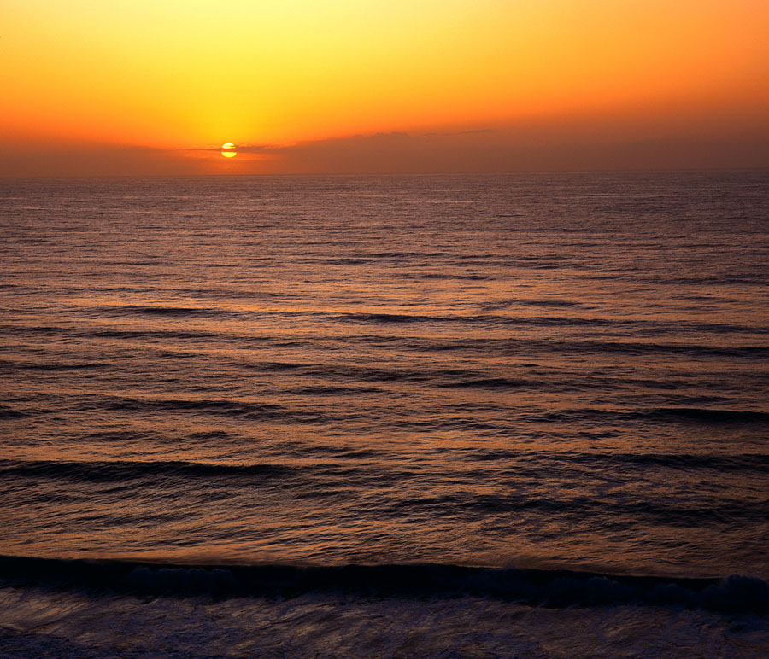
WATERS (17:15)
identified as peoples₁, multitudes₂, nations₃, and tongues₄
the woman sits upon the beast; upon the mountains (power, prestige) and upon the waters (nations)
conclusive evidence that the harlot is not Jerusalem, but Rome

Slide 37
TEN HORNS (17:16)
vassal nations served with ulterior motive of greed and power
pretended to honor Rome but really despised her
compared to in the flesh with Amnon, 2 Sam. 13:15
Satan divided against himself
Notes:
Satan divided…Mark 3:23-26.
Naked is to be shamed.
Eating flesh is a godless barbaric act of savagery. Micah 3:2, 3, “You who hate good and love evil; Who strip the skin from My people, And the flesh from their bones;
3 Who also eat the flesh of My people, Flay their skin from them, Break their bones, And chop them in pieces Like meat for the pot, Like flesh in the caldron."

Slide 38
17:17, 18
“fulfill His purpose”
Jesus is the ruler of the kings of the earth (1:5)
“This decision is by the decree of the watchers, And the sentence by the word of the holy ones, In order that the living may know That the Most High rules in the kingdom of men, Gives it to whomever He will, And sets over it the lowest of men” (Dan. 4:17).
Notes:
We need to know that. We may be confused how the most arrogant most hated of men can rise to such power, yet, God can use that to fulfill His purpose. Neither does it mean that they will not be held accountable and punished when God is done (see Isa. 10:5-12).

Slide 39
Contrast of Two Women
Question 8
Revelation 17
Revelation 19; 21
Great harlot
17:1
Clothed in Riches
17:4
Self-centered
Mother of harlots
Seduced the nations of the earth
Reigns over the kings of earth
Bride
19:7; 21:2, 9
Righteousness
19:8
Christ-centered
Mother of martyrs
The saved nations walk in her light
Submission to Jesus in heaven

Slide 40
Applications
Prostitution is always a sin
1 Cor. 6:15, 16; Pro. 23:27, 28
A prostitute can be forgiven and made just in the sight of God
1 Cor. 6:9-11; Heb. 11:31; Jas. 2:25

Slide 41
Applications
Nations can become corrupt but they cannot dethrone Jesus
Stay confident in the outcome of the war
People can maintain a chosen and faithful status while living in a very wicked world
Evil brings judgment
Evil can rise in great power and influence and then implode

Slide 42
Lessons Against Sin
Do not minimize the pleasures of sin—they are tempting
Do not ignore the true nature of sin—it is degrading
Do not love this present world—it is passing away
Keep your eye on the Lord to not be allured by evil
*From Truth For Today Commentary

